Slide 1







Forecasting Bike-Sharing Demand: Exploring Weather Patterns' Impact on Urban Mobility
Ayan Das
19 - Feb - 2024

Slide 2



OUTLINE
Executive Summary
Introduction
Methodology
Exploratory Data Analysis with SQL
Exploratory Data Analysis with Visualization
Predictive Analysis Results
Shiny Dashboard
Introduction
Screenshot
Interactive Features
Benefits
Results
Key Findings
Data Trends
Implications
Discussion
OVERALL FINDINGS & IMPLICATIONS
Conclusion
Appendix

Slide 3

EXECUTIVE SUMMARY
Analysis Overview
Data collection and preprocessing.
Weather impact on bike demand.
Data Exploration
Identify weather-bike correlations.
Explore trends and patterns.
Model Development
Build predictive regression models.
Evaluate model performance metrics.
Dashboard Implementation
Integrate models into interactive dashboard.
User-friendly features for visualization.
Conclusion & Recommendations
Weather influences bike demand.
Optimize bike availability based on forecasts.

Slide 4

INTRODUCTION
Overview of bike-sharing demand analysis.
Analyzing rental patterns to optimize bike-sharing systems.
Understanding user behavior and demand fluctuations.
Importance of understanding weather impact.
Weather influences rental behavior, impacting system utilization.
Insight into weather-related trends enhances system planning and management.
Objectives of the analysis.
Identify seasonal variations in rental demand.
Explore correlations between weather conditions and rental counts.
Develop predictive models to forecast rental demand accurately.
Scope of data collection and analysis.
Incorporating Seoul Bike Sharing Dataset.
Utilizing OpenWeather API.

Slide 5

METHODOLOGY
Data collection process.
Preprocessing and cleaning steps.
Feature selection and engineering.
Model development approach.
Selection of regression techniques.
Parameter tuning and validation.
Visualization (Dashboard) implementation.
Integration of predictive models.
Designing user-friendly features.

Slide 6

Exploratory Data Analysis with SQL
Dataset Overview:
Full year data with no zero bike count records.
Spring and Winter have same records, while Autumn has the least and Summer has the most.
Weather Observations:
Temperature range is significant, likely impacting bike rentals.
Precipitation (rainfall and snowfall) is rare, occurring mainly in fourth quartiles.
Average windspeed is light at 1.7 m/s.
Expected Records for a Full Year:
Expected number of records: 8760.

Slide 7
Exploratory Data Analysis with SQL
4.Functioning Day Records:
Records for 'Functioning Day': 8465.
No records for 'Non-Functioning Day'.
5.Seasonal Aggregated Measures:
Spring has highest total rainfall, while Winter has highest total snowfall.
Overall Insights:
Observations provide insights into seasonal patterns and weather conditions influencing bike rental demand.

Slide 8
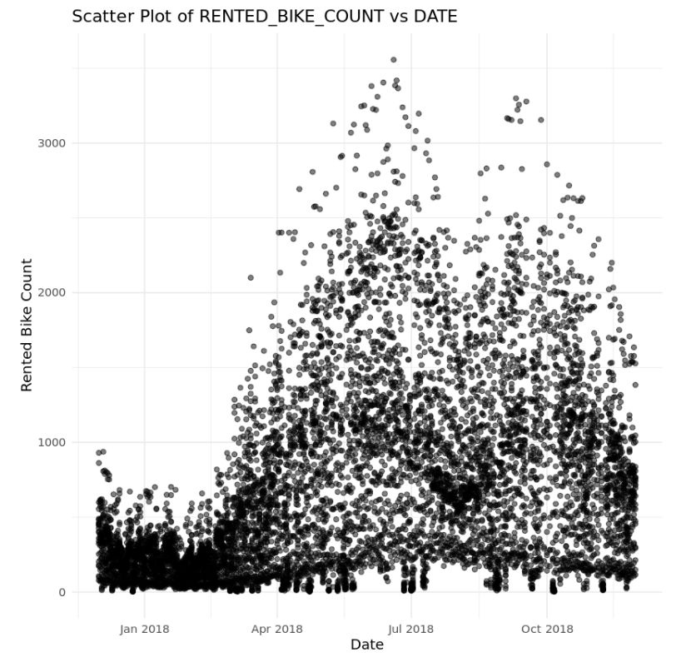
Exploratory Data Analysis with Visualization
Seasonal Patterns
Peak bike rental months: May and June (> 3000 counts).
Strong rental activity: September and October.
Lower demand: December and January.
Distinct peaks in June and September.

Slide 9
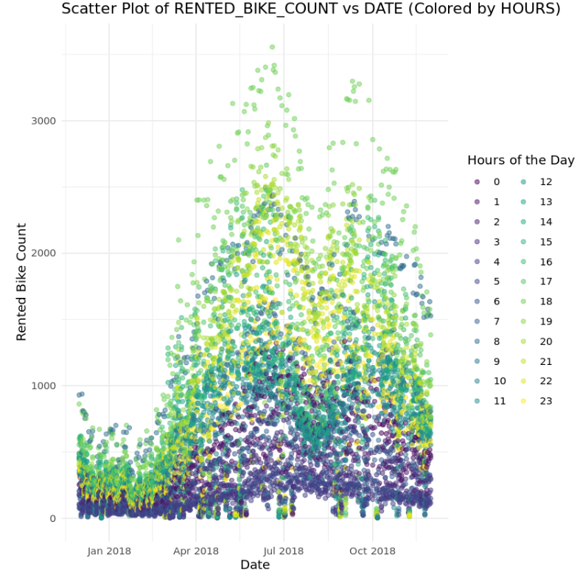
Exploratory Data Analysis with Visualization
Daily Trends
Peak rental hours: 8 pm to 10 pm, especially in May and June.
Morning rentals stable from Nov to Feb (100 bikes, 4 am to 7 am).
Apr to Oct morning rentals increase (300-400 bikes).

Slide 10
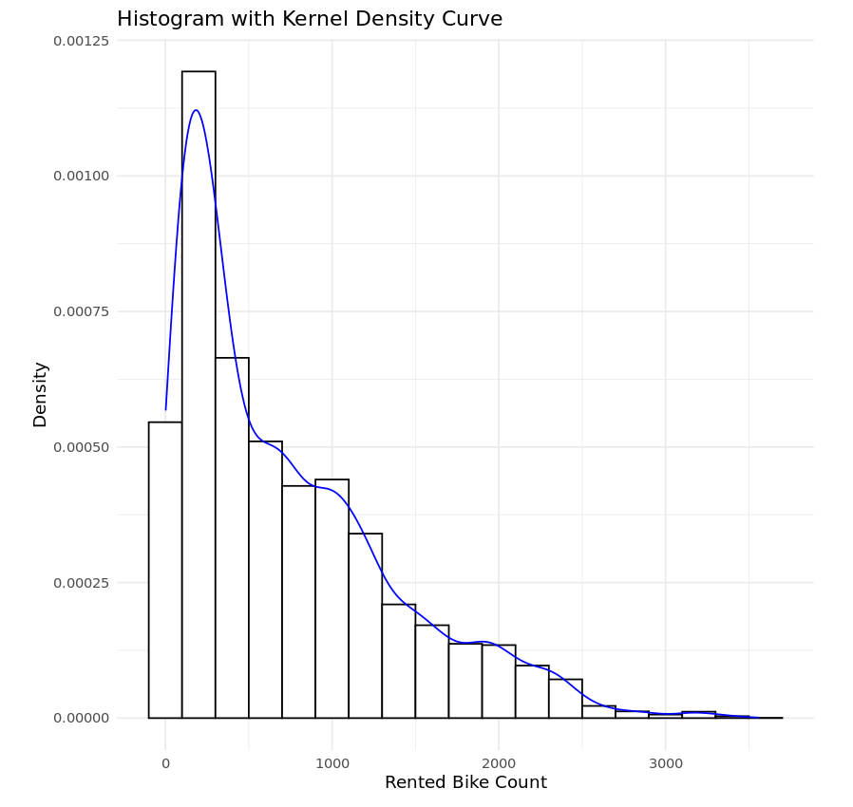
Exploratory Data Analysis with Visualization
Histogram Analysis
Rental counts cluster around mode (~250 bikes).
Additional peaks at ~700, 900, 1900, 3200 bikes suggest hidden modes.
Distribution's tail shows rare but significant spikes in demand.
This insight underscores the importance of understanding both the typical rental patterns and the potential for unexpected surges in bike-sharing demand.

Slide 11
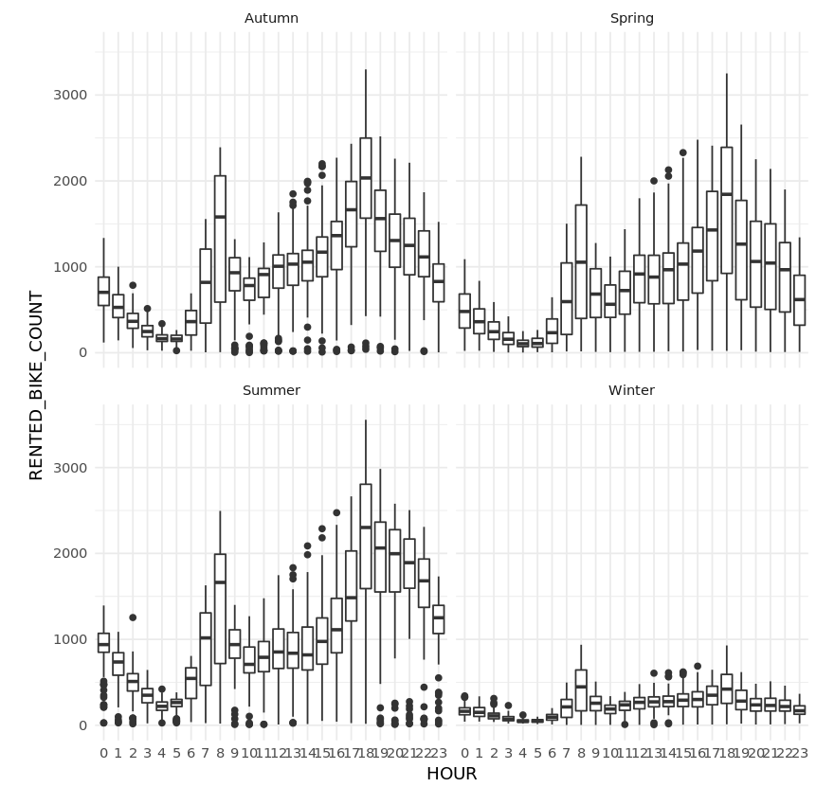
Exploratory Data Analysis with Visualization
Seasonality Impact
Scale of bike rental counts changes with seasons.
Peak demand times consistent across all seasons (8 am and 6 pm).

Slide 12
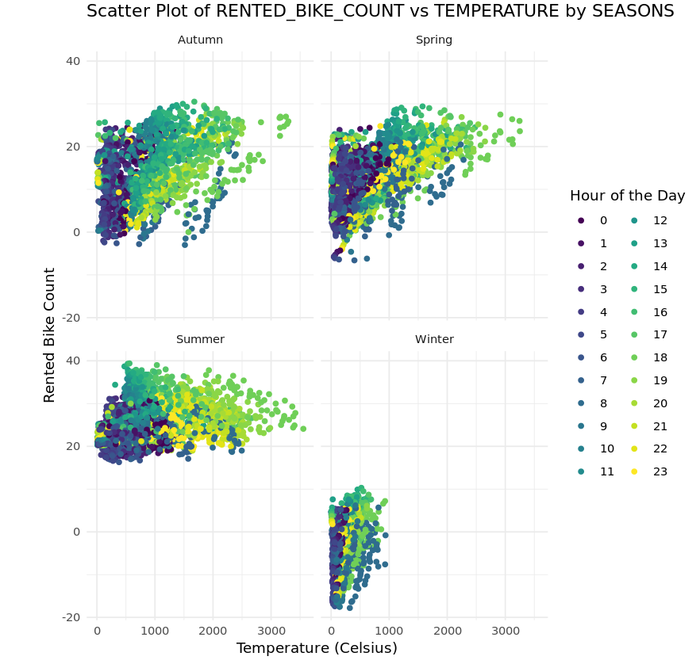
Exploratory Data Analysis with Visualization
Scatter Plot Analysis
Strong correlations observed as approximately linear patterns.
Scatter Plot: Rented Bike Count vs Temperature by Seasons.
Seasonal grouping highlights importance of seasonality in explaining rental counts.

Slide 13
Exploratory Data Analysis with Visualization
Visualization Comparison
Facet Wrap seasons: Shows importance of seasonality.
Comparison with non-seasonal grouping emphasizes seasonal impact.

Slide 14
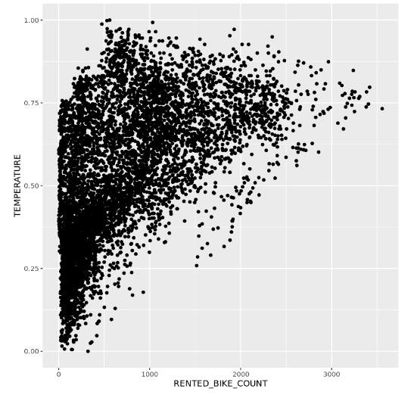
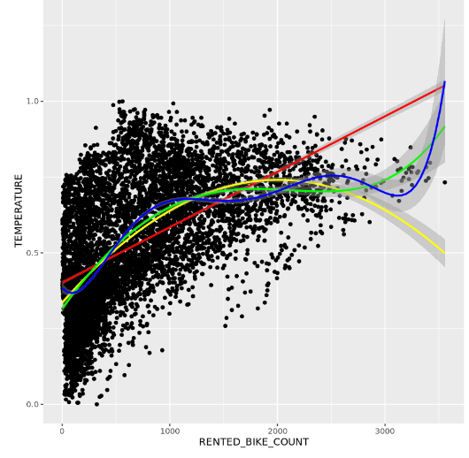
Predictive Analysis Results
Non-Linear Relationships:
Correlation between RENTED_BIKE_COUNT and TEMPERATURE appears non-linear.
Fitting polynomial regression model with higher-order terms on important variables.

Slide 15
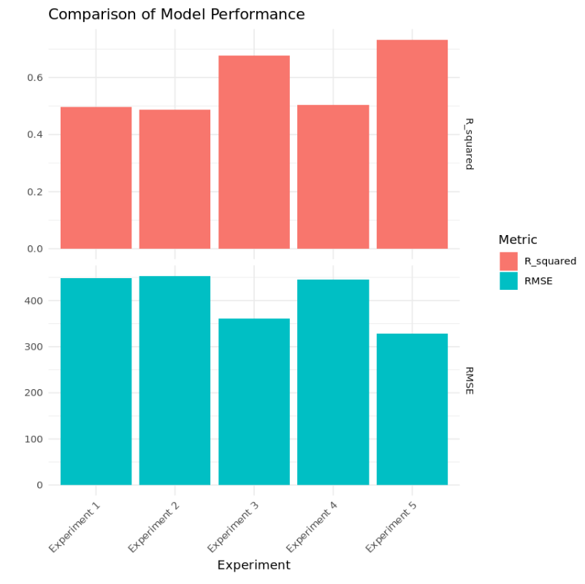
Predictive Analysis Results
Formula Overview:
Predictive Model Formula: Experiment 5
RENTED_BIKE_COUNT ~ poly(TEMPERATURE,3) + poly(HUMIDITY,2) + TEMPERATURE * HUMIDITY + SPRING * (WIND_SPEED + VISIBILITY) + SUMMER * DEW_POINT_TEMPERATURE + WINTER * SOLAR_RADIATION + WIND_SPEED + VISIBILITY + DEW_POINT_TEMPERATURE + SOLAR_RADIATION + RAINFALL + SNOWFALL + AUTUMN + SPRING + SUMMER + WINTER + HOLIDAY + NO_HOLIDAY + 0H + 1H + 2H + 3H + 4H + 5H + 6H + 7H + 8H + 9H + 10H + 11H + 12H + 13H + 14H + 15H + 16H + 17H + 18H + 19H + 20H + 21H + 22H + 23H
RMSE: 327.5851
R-squared: 0.7332623
Comparison with Other Models:
Evaluated five models
This model outperforms others
Best balance between RMSE and R-squared
Addressing Model Complexity:
Used regularization techniques to address overfitting.
Utilized glmnet engine for Lasso, Ridge, and Elastic Net regularization.

Slide 16
Shiny Dashboard: Introduction
Brief Overview:
Shiny dashboard is an interactive visualization tool developed for analyzing bike-sharing demand.
Designed to provide users with intuitive access to weather forecasts and bike rental predictions.
Purpose:
Enhances data exploration and decision-making for urban planners, bike-sharing operators, and other stakeholders.
Offers a user-friendly interface for accessing and interpreting complex data insights.

Slide 17
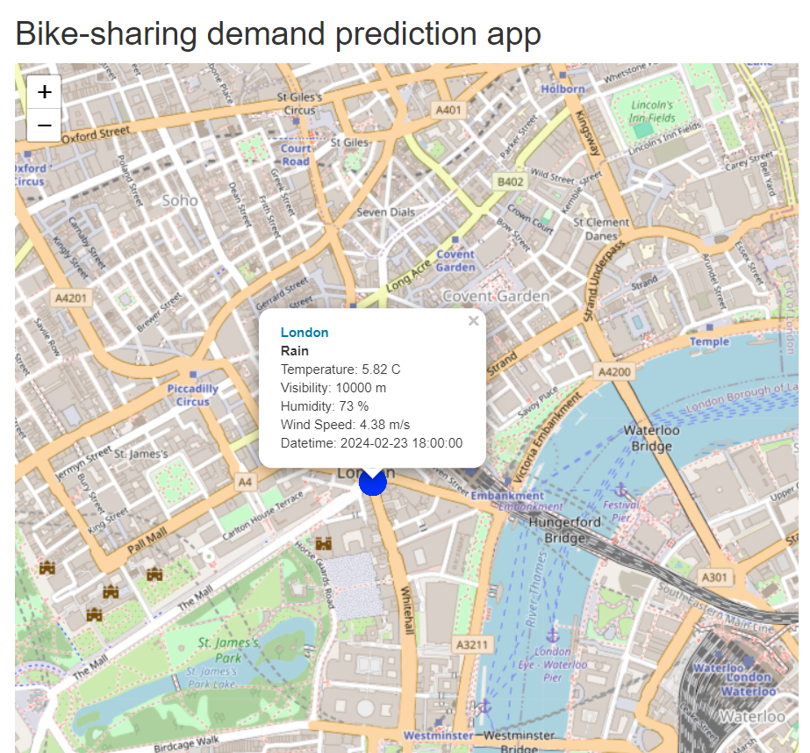
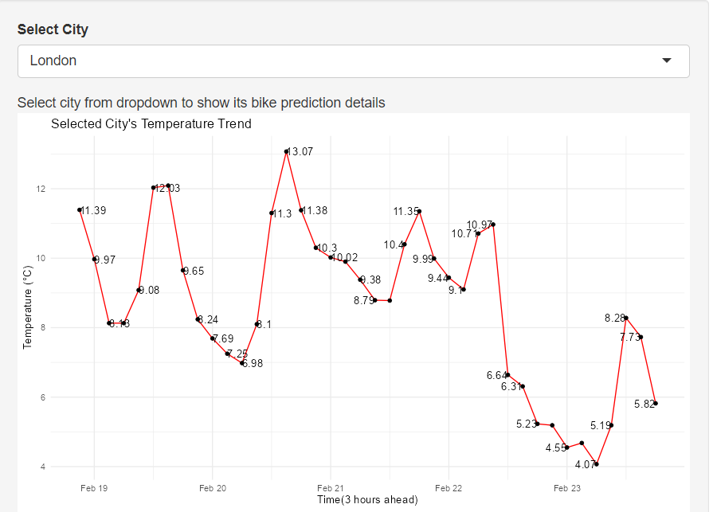
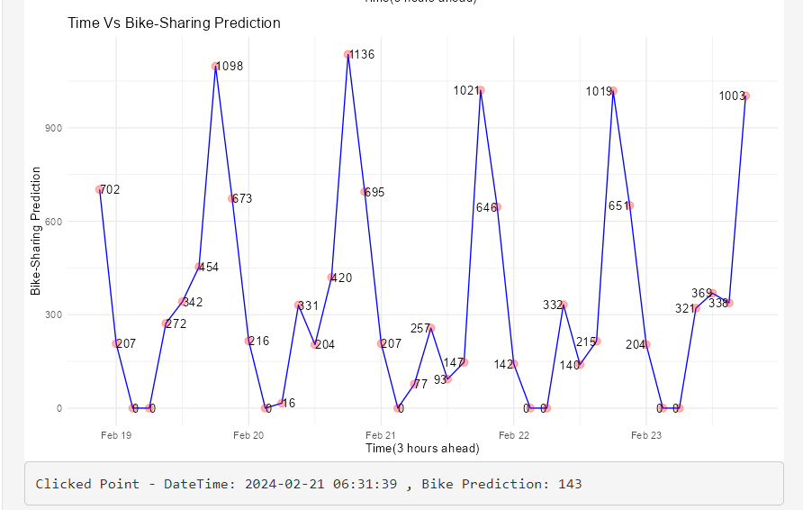
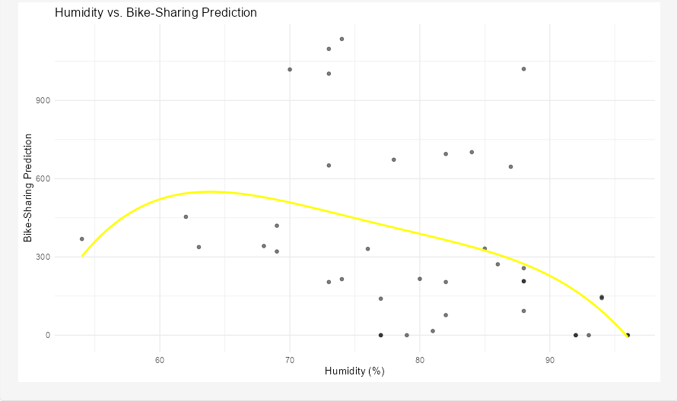
Shiny Dashboard Screenshot:

Slide 18
Shiny Dashboard: Interactive Features
Map Visualization:
Interactive map displaying bike-sharing demand across urban areas.
Users can hover over locations to view rental counts and weather conditions.
Filter Options:
Filters for selecting specific time periods, weather parameters, and geographic regions.
Enables users to customize data views based on their preferences.
Prediction Charts:
Dynamic charts illustrating predicted bike-sharing demand trends over time.
Users can toggle between different variables to explore their impact on rental counts.

Slide 19
Shiny Dashboard: Benefits
Enhanced Data Exploration:
Provides a visually appealing platform for exploring complex datasets.
Allows users to interactively analyze correlations between weather factors and bike rental demand.
Improved Decision-Making:
Empowers stakeholders to make informed decisions based on real-time data insights.
Facilitates proactive planning and resource allocation to optimize bike-sharing operations.
User-Friendly Interface:
Intuitive design makes it easy for users to navigate and interpret data.
Promotes user engagement and encourages data-driven actions for urban planning and bike-sharing management.

Slide 20
RESULTS
Key Findings:
Weather conditions significantly impact bike-sharing demand.
Temperature and humidity are strong predictors of rental counts.
Weekdays exhibit higher demand compared to weekends.
Seasonal variations influence rental patterns.
Regression models achieve high accuracy in predicting demand.

Slide 21
RESULTS
Data Trends:
Increase in bike-sharing demand during peak hours.
Variation in demand based on weather conditions and seasons.
Correlation between temperature, humidity, and rental counts.
Notable differences in demand between weekdays and weekends.
Implications:
Urban planners can use weather forecasts to optimize bike availability.
Bike-sharing operators can adjust resources based on demand patterns.
Enhancing infrastructure during peak hours can improve user experience.
Targeted marketing campaigns can be developed to capitalize on seasonal variations.

Slide 22

DISCUSSION
Key Insights:
Weather conditions strongly influence bike-sharing demand, with temperature and humidity being significant predictors.
Weekday demand differs from weekends, suggesting varying usage patterns.
The Shiny dashboard provides valuable insights for urban planners and bike-sharing operators to optimize resources.

Slide 23
DISCUSSION
2.Practical Implications:
Urban planners can use weather forecasts to strategically allocate bike resources and enhance user experience.
Bike-sharing operators can adjust operations based on demand fluctuations, improving service efficiency.
3.Limitations:
While the analysis provides valuable insights, it's important to acknowledge data limitations and potential biases.
Future research could explore additional factors impacting bike-sharing demand for a more comprehensive understanding.

Slide 24
OVERALL FINDINGS & IMPLICATIONS
Findings:
Weather conditions, particularly temperature and humidity, strongly influence bike-sharing demand.
Weekday usage patterns differ significantly from weekends, indicating potential opportunities for targeted resource allocation.
The Shiny dashboard provides an effective platform for visualizing weather forecasts and bike-sharing predictions, facilitating data-driven decision-making.
Implications:
Weather-informed planning: Utilize weather forecasts to optimize bike availability and infrastructure, enhancing user satisfaction and sustainability.
Operational efficiency: Adjust fleet management strategies based on demand patterns to improve service reliability and resource allocation.
Data-driven decision-making: Leverage interactive visualization tools like the Shiny dashboard to facilitate informed decisions and innovation in urban mobility planning.

Slide 25

CONCLUSION
Key Takeaways:
Weather significantly influences bike-sharing demand, with temperature and humidity being key predictors.
Weekday and weekend usage patterns vary, highlighting the need for tailored resource allocation strategies.
The Shiny dashboard offers a valuable tool for visualizing weather forecasts and bike-sharing predictions, enabling data-driven decision-making.
Importance of Data Analysis:
Understanding weather impacts on bike-sharing demand is crucial for optimizing urban transportation systems.
Data-driven approaches, supported by interactive visualization tools, empower stakeholders to make informed decisions and enhance operational efficiency.

Slide 26
CONCLUSION
3.Future Directions:
Further research is needed to explore additional factors affecting bike-sharing demand and to address any data limitations.
Continued development of interactive tools can drive innovation in urban mobility planning and improve user experience.
4.Thank You:
Thank you for your attention and engagement. Your insights and feedback are valuable for advancing research in urban transportation and bike-sharing management.

Slide 27
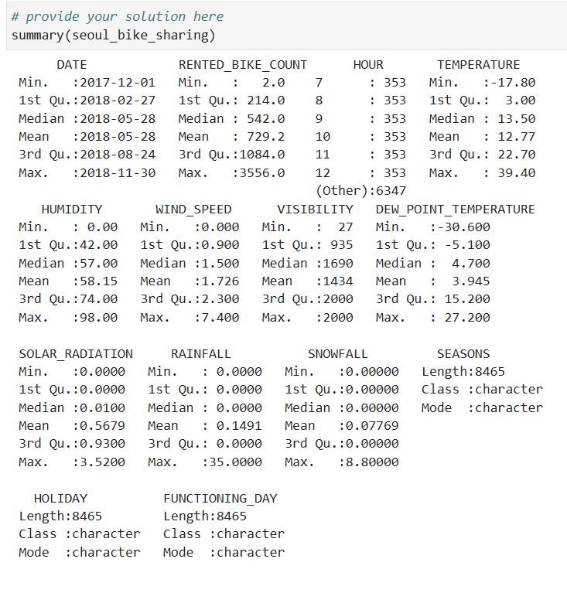
Appendix
SQL Code Snippets:

Slide 28
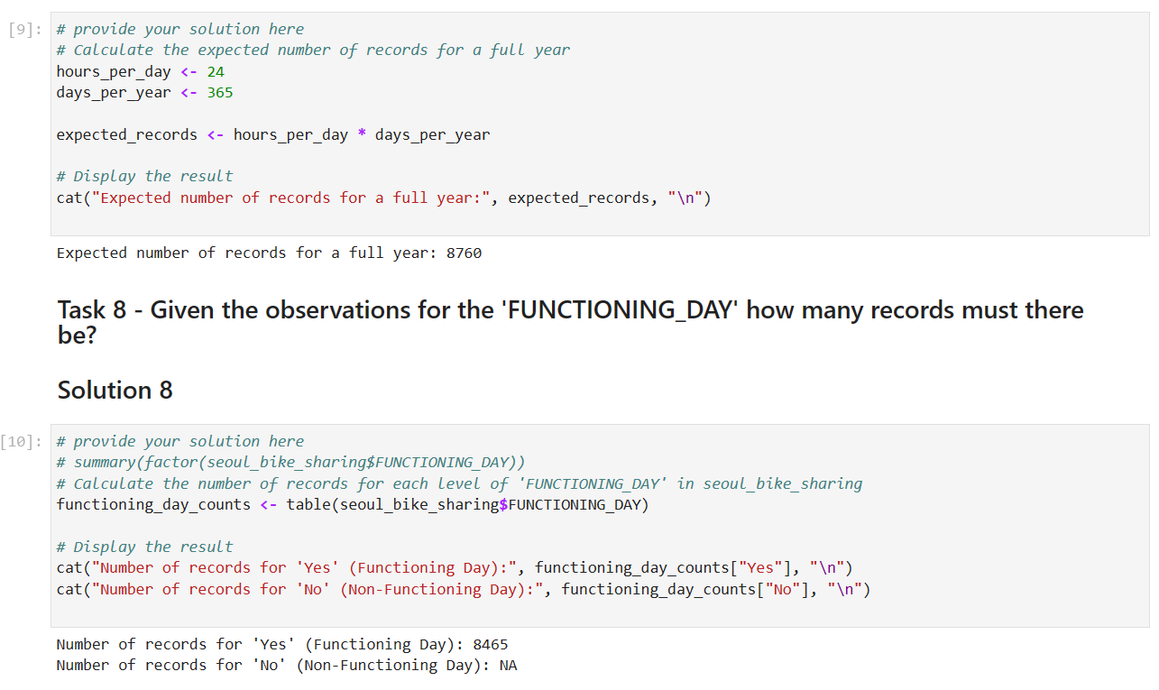
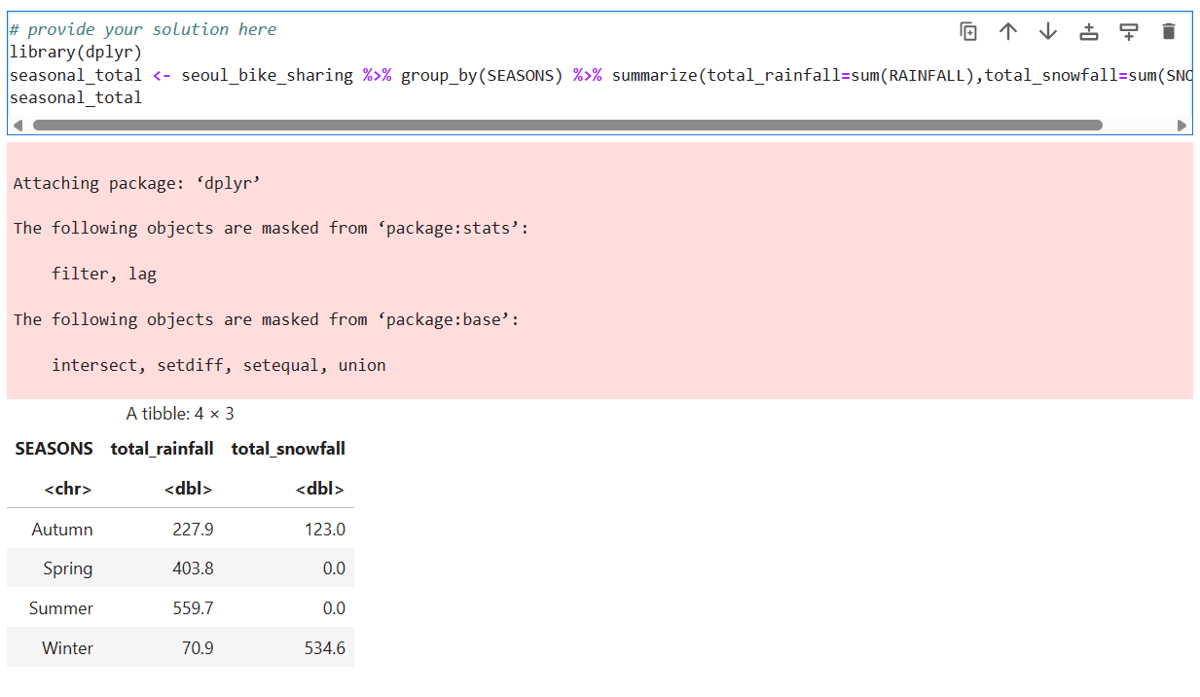
Appendix
SQL Code Snippets:

Slide 29
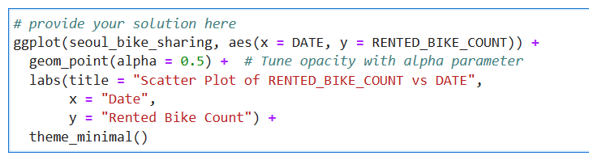
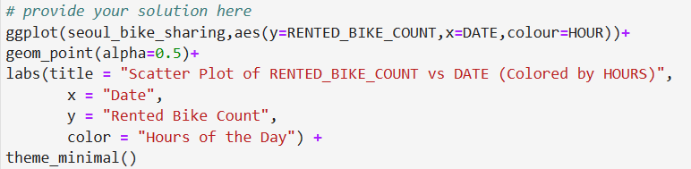
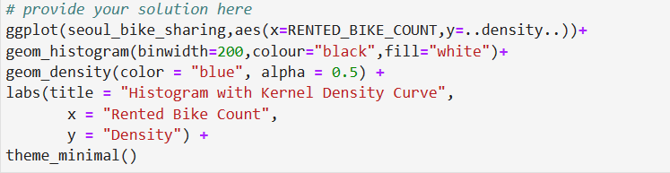
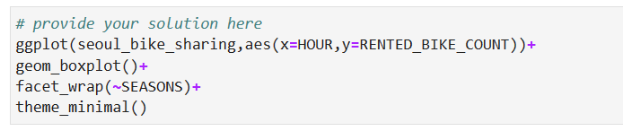
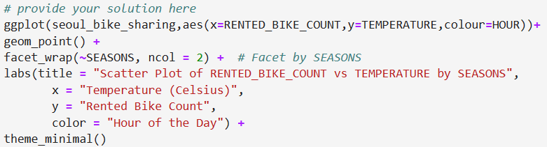
Appendix
R Code Snippets:

